Slide 1
MLA FORMAT
What is MLA and why do we use it?

Slide 2
What is MLA?
MODERN LANGUAGE ASSOCIATION
MLA Style establishes standard of written communication concerning:
Formatting and page layout
Stylistic technicalities (ex: abbreviations, footnotes, quotations)
Citing sources
Preparing a manuscript for publication in certain disciplines

Slide 3
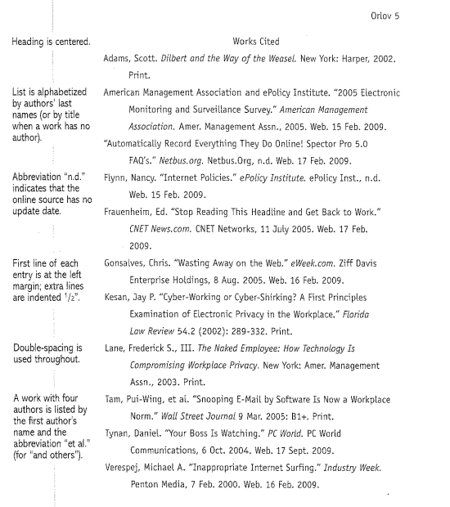

Slide 4
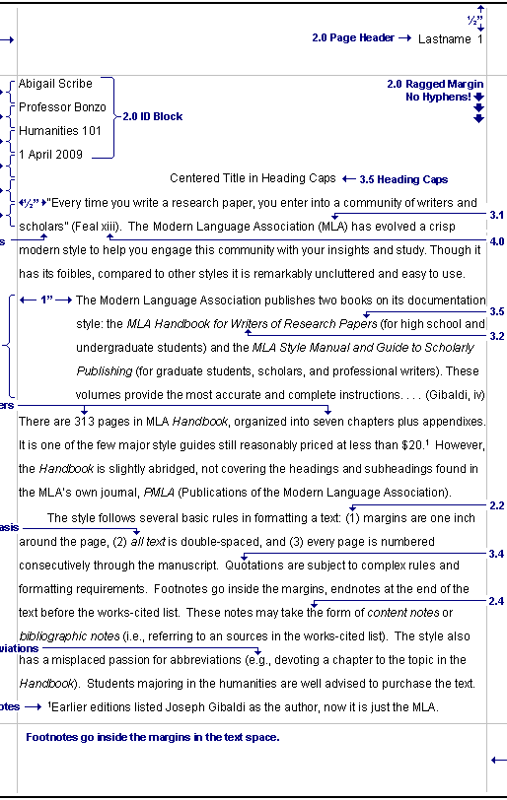
Why Use MLA?
Provide your readers with cues to follow your ideas
Let your reader focus on your ideas and writing without getting distracted
Establish your credibility

Slide 5
Basic Style for Citations of Electronic Sources
Author/editors names
Article name in quotation marks
Title of Website
Version number
Publisher information – name and publishing date
Page numbers
Medium of publication
Date you accessed the material

Slide 6
MLA Website Citation Format
Author/editor’s last name, first name. Name of Site. Version
number. Name of institution/organization
affiliated with the site, date of resource creation.
Medium of publication. Date of access.

Slide 7
EasyBib.com
Save time by making citing sources automatically!
But make sure you check your work!

Slide 8
WORKS CITED – Basic Rules
Begin Works Cited page on separate page at the end of the paper
Label the page Works Cited and center it
Double space all citations, but do not skip spaces between entries
Indent the second and subsequent lines of citations 0.5”

